Slide 1
Introduction to Systems and Modeling and Simulation
Dr. Feng Gu

Slide 2
Weather Prediction Example
Possible models to predict the weather tomorrow
1. Mystery-based models (e.g., whenever my right eyelid twitches, it is going to rain tomorrow)
2. Statistic models (historical temperature on this day of the year; Given that is rained today, what is the probability that it will rain tomorrow)
3. Time series models (e.g., moving average)
4. Neural network (using NN to represent the dynamic system, e.g., today‘s weather type, wind level, time of year -> tomorrow’s weather type)
5. Expert systems (combining all observations, patterns, rules, and data to give predictions)
6.Simulation model (explicitly model the space and the physical process of the system)
How do you predict the stock market?

Slide 3
A General View of M&S
A General View of M&S
System
Model
Experiment
Simulation
Why M&S
Simulation languages

Slide 4
System
A system is an object or collection of objects whose properties we want to study.
(From ACIMS website): Real or virtual environment viewed as a source of observational data or more specifically, behavior.
Why do we want to “study” a system?
-Study a system to understand it in order to build it. This is the engineering point of view.
-Satisfy human curiosity, e.g. , to understand more about nature—the natural science viewpoint.
A system can contain subsystems which are themselves systems.
Natural and artificial systems
An important property of systems is that they should be observable.
-Input and output

Slide 5
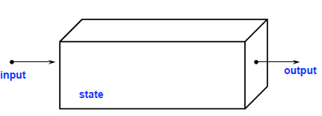
System
Controllable: we can influence their behavior through inputs
Uncontrollable
Observable: : from the output, we can determine the behavior of the system
Unobservable

Slide 6
Experiments
An experiment is the process of extracting information from a system by exercising its inputs.
To perform an experiment on a system it must be both controllable (for inputs) and observable (for outputs).
-Inaccessible and uncontrollable inputs are sometimes called disturbance inputs.
-Unobservable outputs are sometimes called internal states.
Practical problems associated with experiments.
-The experiment might be too expensive
-The experiment might be too dangerous (chemical systems)
-The system needed for the experiment might not yet exist

Slide 7
Model
A model of a system is anything an "experiment" can be applied to in order to answer questions about that system.
This implies that a model can be used to answer questions about a system without doing experiments on the real system.
A model is always related to the system it models and the experiments it can be subject to. A model of a system might be valid for one experiment on the model and invalid for another.
The term model validation, always refers to an experiment or a class of experiments to be performed.

Slide 8
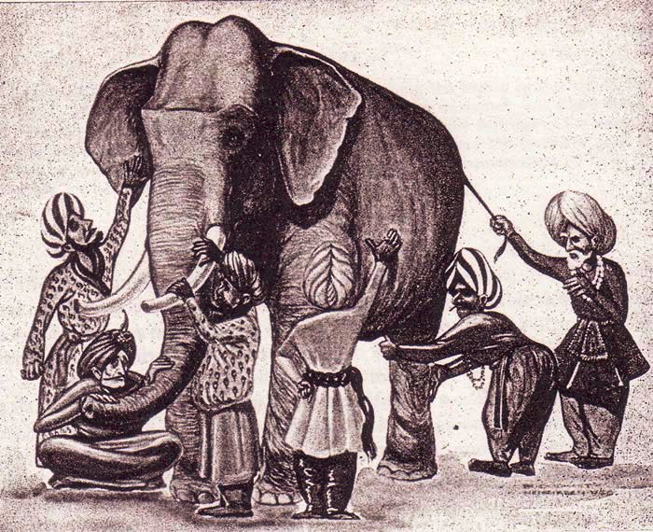
Model
http://www.thepoachedegg.net/the-poached-egg/2010/06/christian-apologetics-blind-men-the-elephant-and-the-zoo.html

Slide 9
Model
A representation of an object, a system, or an idea in some form other than that of the entity itself. (Shannon)

Slide 10
Types of models
Different kinds of models depending on how the model is represented
-Mental model—a statement like "a person is reliable" helps us answer questions about that person's behavior in various situations.
-Verbal model—this kind of model is expressed in words. For example, the sentence "More accidents will occur if the speed limit is increased" is an example of a verbal model. Expert systems is a technology for formalizing verbal models. Many models in sociology and psychology are verbal models.
-Physical model—this is a physical object that mimics some properties of a real system, to help us answer questions about that system. For example, prototype buildings, airplanes, etc.
-Mathematical model—a description of a system where the relationships between variables of the system are expressed.

Slide 11
Simulation
A simulation is an experiment performed on a model.
Examples:
-A simulation of an industrial process such as steel or pulp manufacturing, to learn about the behavior under different operating conditions in order to improve the process.
-A simulation of vehicle behavior, e.g., of a car or an airplane, for the purpose of providing realistic operator training.
-A simulation of a simplified model of a packet-switched computer network, to learn about its behavior under different loads in order to improve performance.
It is important to realize that the experiment description and model description parts of a simulation are conceptually separate entities.
-Consider the steel manufacturing simulation, what is the model description and what is the experiment description?
The value of the simulation results is dependent on how well the model represents the system.

Slide 12
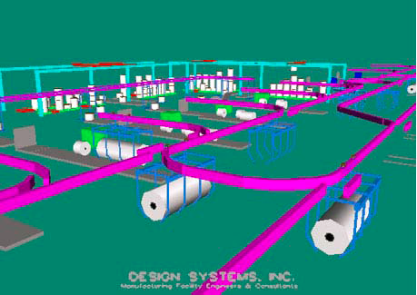
Example of simulation
http://www.dsidsc.com/simulation-engineering-bottleneck-id.asp

Slide 13

Simulation and analytical techniques
Simulation is typically considered as a different approach from analytical techniques. They differ in the following two ways:
-Ability of dealing with complexity: analytical techniques usually apply only under a set of simplifying assumptions.
-Way of work: analytical solutions are derived from mathematical analysis; simulation results are generated from simulations.
Consider the following example:
  -Using analytical techniques to show how r changes over time.
  -Using simulation to show how r changes over time.

Slide 14
Simulation
Experiments are too expensive, too dangerous, or the system to be investigated does not yet exist.
The time scale of the dynamics of the system is not compatible with that of the experiment. For example, it takes millions of years to observe small changes in the development of the universe.
Variables may be inaccessible in real system. In simulation all variables can be controlled.
Easy manipulation of models.
Suppression of disturbances and suppression of second-order effects. This can allow us to isolate particular effects and thereby gain a better understanding of those effects.

Slide 15
Simulation
Falling in love with a model—the Pygmalion effect (who falls in love with one of his sculpture works).
Forcing reality into the constraints of a model
-the Procrustes effect (who forces victims to fit into a torturing bed).
-if all you have is a hammer, everything looks like a nail
Forgetting the model's level of accuracy. All models have simplifying assumptions and we have to be aware of those in order to correctly interpret the results.

Slide 16
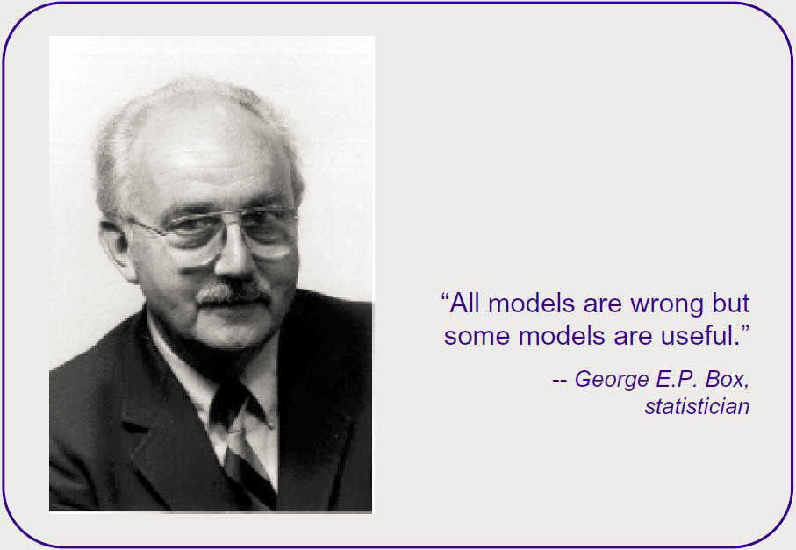
Simulation
From Michael W. Macy, Social Life in Silico: Population Health from the Bottom Up, presentation in NIH, July 13, 2007

Slide 17
Kinds of mathematical models
One important aspect is whether the model incorporates dynamic time-dependent properties or is static. A static model can be defined without involving time. Example: voltage-current relation for a resistor and a capacitor.
Another dividing line is between models that evolve continuously over time, and those that change at discrete points in time.
A third dividing line is between quantitative and qualitative models.
Some phenomena in nature are conveniently described by stochastic processes and probability distributions, e.g., noisy radio transmissions or atomic-level quantum physics. Such models might be labeled stochastic or probability-based models where the behavior can be represented only in a statistic sense, whereas deterministic models allow the behavior to be represented without uncertainty. Note that a stochastic phenomena can also be modeled in a deterministic way.

Slide 18
Choose simulation tools
Assuming simulation is the appropriate means, three alternatives exist:
1. Build Model in a General Purpose Language
2. Build Model in a General Simulation Language
3. Use a Special Purpose Simulation Package

Slide 19
General purpose languages
Advantages:
-Little or no additional software cost
-Universally available (portable)
-No additional training (Everybody knows…(language X) ! )
Disadvantages:
-Every model starts from scratch
-Very little reusable code
-Long development cycle for each model
-Difficult verification phase

Slide 20
General simulation languages
Advantages:
-Standardized features often needed in modeling
-Shorter development cycle for each model
-Much assistance in model verification
-Very readable code
Disadvantages:
-Higher software cost (up-front)
-Additional training required
-Limited portability

Slide 21
General simulation languages
GPSS
-Block-structured Language
-Interpretive Execution
-FORTRAN-based (Help blocks)
-World-view: Transactions/Facilities
SIMSCRIPT II.5
-English-like Problem Description Language
-Compiled Programs
-Complete language (no other underlying language)
-World-view: Processes/ Resources/ Continuous

Slide 22
General simulation languages
MODSIM III Modern Object-Oriented Language
-Modularity Compiled Programs
-Based on Modula2 (but compiles into C)
-World-view: Processes
SIMULA
-ALGOL-based Problem Description Language
-Compiled Programs
-World-view: Processes

Slide 23
General simulation languages
SLAM Block-structured Language
-Interpretive Execution
-FORTRAN-based (and extended)
-World-view: Network / event / continuous
CSIM
-process-oriented language
-C-based (C++ based)
-World-view: Processes

Slide 24
Special simulation packages
Advantages:
-Very quick development of complex models
-Short learning cycle
-No programming--minimal errors in usage
Disadvantages
-High cost of software
-Limited scope of applicability
-Limited flexibility (may not fit your specific application)

Slide 25
Special simulation packages
NETWORK II.5
-Simulator for computer systems
The Network Simulator - ns-2
-http://www.isi.edu/nsnam/ns/
OPNET
-Simulator for communication networks, including wireless networks
COMNET III
-Simulator for communications networks
SIMFACTORY
-Simulator for manufacturing operations

Slide 26
Challenges of modeling
Modeling is to develop an abstraction of a system.
A good model should capture only the relevant information, ignore the irrelevant information.
What is relevant (or irrelevant) depends on your modeling goal.

Slide 27
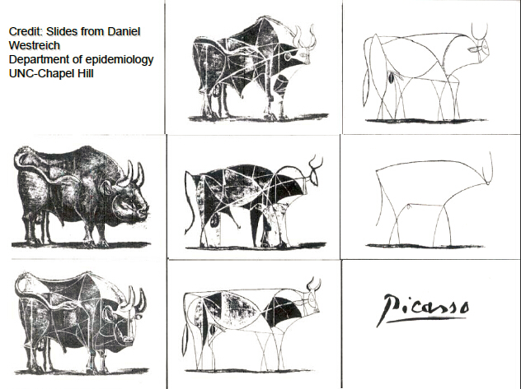

Slide 28
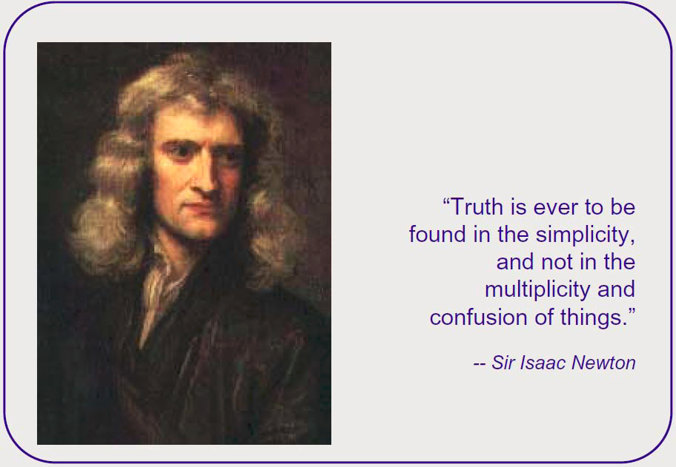
from: Michael W. Macy, Social Life in Silico: Population Health from the Bottom Up, presentation in NIH, July 13, 2007

Slide 29
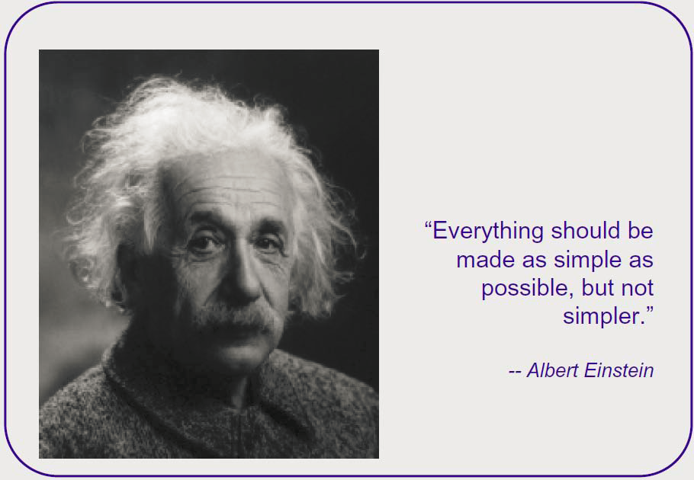
from: Michael W. Macy, Social Life in Silico: Population Health from the Bottom Up, presentation in NIH, July 13, 2007

Slide 30
Discussions
Sometimes we do not have a full understanding of the systems under study (e.g., a social system).
-How can we develop good models for these systems?
  -Does it mean the simulation results are built into the model (we build a model to generate results that we wanted to see)?
  The principles built into the model should be as objective (not subjective) as possible.
  Hypothesis can be built into the model, but then the purpose is to test if the hypothesis leads to expected outputs.

Slide 31
Two aspect of systems theory
Levels of system specification
Systems specification formalisms

Slide 32
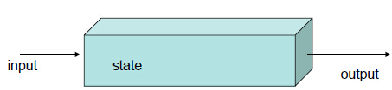
Systems concepts
System theory distinguishes between system
- Structure (the inner constitution of a system)
- Behavior (the outer manifestation)
The internal structure of a system includes its state and state transition mechanism as well as the state-to-output mapping.
Two relations:
- From structure to behavior: Knowing the structure allows us to deduce (analyze, simulate its behavior).
- From Behavior to structure: the modeling process

Slide 33
Decomposition and composition
Decomposition: how a system may be broken down into component systems.
Composition: how component systems may be coupled to form a larger system.
System theory is closed under composition in that the structure and behavior of a composition of systems can be expressed in the original system theory terms.
Hierarchical construction.
Question: How about OO?
- The composition of multiple objects is not an object, It is a subsystem.

Slide 34
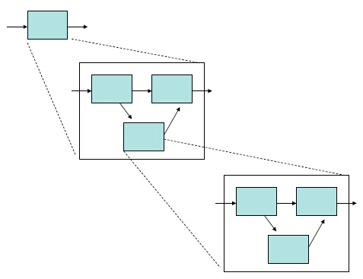
Hierarchical construction

Slide 35
Decomposition and composition
Modular systems have recognized input and output ports through which all interaction with the environment occurs
They can be coupled together
The difference between decomposed systems and under-composed systems provides a first introduction to levels of system specification.

Slide 36
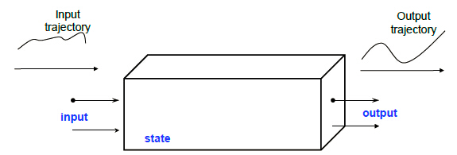
System
We view systems as having input and output ports through which they can interact with other systems.
The term “port” signifies a specific means of interacting with the system. Ports are the only channel through which one can interact with the system.
The time-indexed inputs to systems are called input trajectories.
The time-indexed outputs are called output trajectories.
State and initial state
Examples: the heating system of the building; a lecture classroom

Slide 37
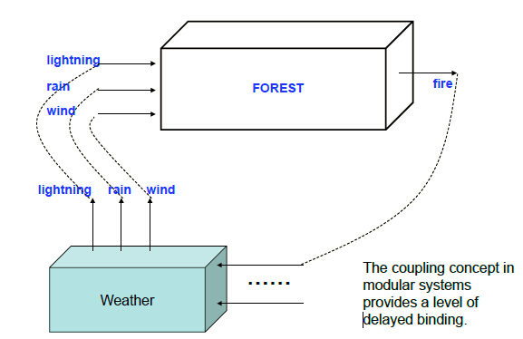
A forest system

Slide 38
Relation to Object Orientation
Both objects and system models share a concept of internal state
However, mathematical systems are formal structures that operate on a time base, whereas programming objects typically do not have an associated temporal semantics. Also, objects are not hierarchical or modular in the sense as described before.
The coupling concepts provides advantages
- A model can be developed and tested as a stand-alone unit
-Be placed in a model repository and reactivated at will
- Be reused in any application context in which its behavior is appropriate and couplings to other components makes sense
From performance point of view., OO is more efficient.
OO provides supporting computation mechanism for system modeling.

Slide 39
Levels of system knowledge
Level 0: source; Level 1: data; Level 2: generative; Level 3: structure
System analysis: moving from higher to lower levels.
System inference: moving from lower to higher levels. Here the system already exists.
System design: moving from lower to higher levels. Here the system does not exist.

Slide 40
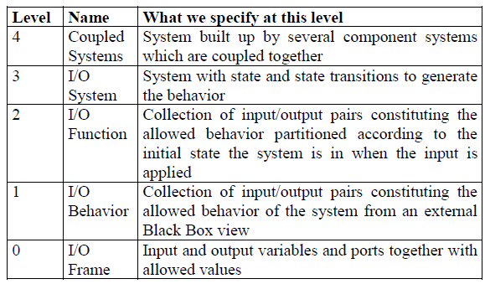
Hierarchy of systems specification

Slide 41
System specification formalism
DESS: differential equation
DTSS: difference equation
DEVS: discrete event

Slide 42
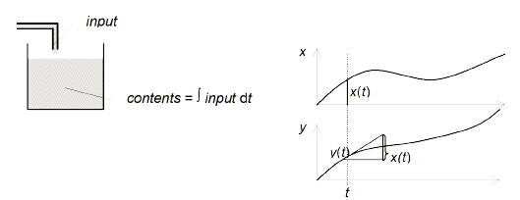

A continuous system
One can imagine it as a reservoir with infinite capacity. Whatever is put into the reservoir is accumulated – with a negative input value meaning outflow. The state of the reservoir is its current contents. When we want to express this in equation form we need a variable to represent the current contents. This is our state variable q. The current input x represents the rate of current change of the contents which we express by equation
d q(t)/dt=x(t)
And the output y is equal to the current state
y(t)=q(t).

Slide 43
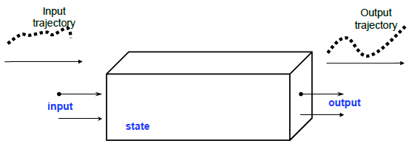
Discrete time systems
Continuous systems-differential equation system specification. Example: a water tank, a heat diffusion system, etc.
Discrete time systems-difference equation-discrete time system specification. Example: computer implementation for a water tank, a heat diffusion system, weather change in a daily basis, etc.
Discrete event systems?

Slide 44
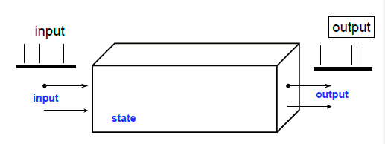
Discrete event systems
The system is driven by event.
Discrete time system is a special case of discrete event systems.
Discrete event system specification (DEVS)
FSM, petri net, etc.

Slide 45
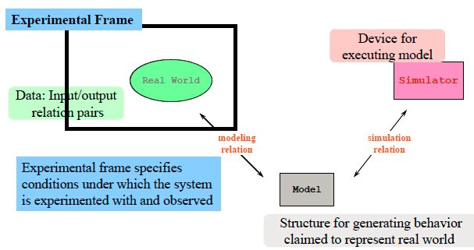
M & S framework

Slide 46
Simulation framework
Model, simulator, real system, and EF
-Real system
-Model
- Simulator
-Experimental frame
How about a structure of EF?
-Generator
-Transducer
-Acceptor

Slide 47
Simulation framework
Time-logic time, real time, wall clock time,…
-logical time vs. physical time
-local time vs. global time
Different types of simulation
-Fast simulation vs. real time simulation
-Centralized simulation vs. distributed simulation

Slide 48
Simulation framework
Random number generation
Simulation correctness
-logical simulator
-multiple runs of the same simulation
-random number is not considered as stochasticity if random number is repeatable
-stochasticity at the model level such as a bag of messages that are not explicitly specified which one to process first. Stochasticity at the simulation level-not allowed, however is hard to prevent especially in parallel and distributed simulation

